Slide 1
DSE 6220
Big Data
Hadoop & Spark
Week 5

Slide 2
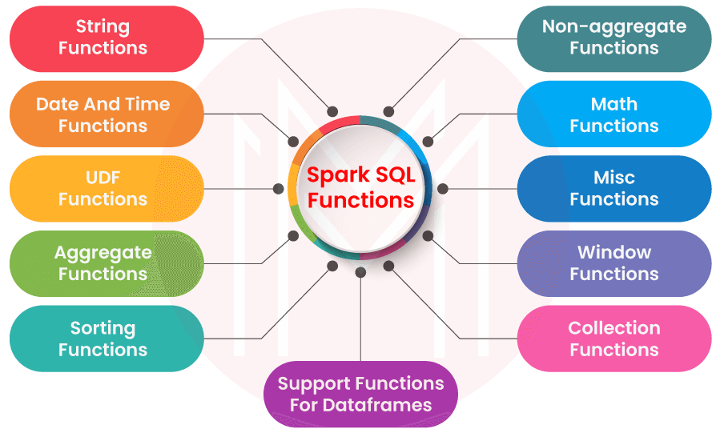
Spark SQL and the Underlying Engine
Allows developers to use ANSI SQL
Unifies Spark components
Standard connectivity
Connects to Apache Hive
Read and writes structured data
Offers an interactive Spark SQL shell
Provides a bridge to external tools via ODBC/JDBC connectors
Generates optimized query plans for the JVM

Slide 3
Spark Tables & Views
Spark does not utilize its own metastore, instead it uses the Hive metastore on Hadoop
You can change this with the config variable: spark.sql.warehouse.dir
Manages & Unmanaged tables
Managed: Spark manages the metadata and the data in the file store
Unmanaged: Spark only manages the metadata
Views are temporary tables that will disappear after your SparkSession is closed
Temporary vs Global Temporary Views
Temporary: tied to a single SparkSession within a Spark app
Global Temporary: Visible across multiple SparkSessions within a Spark app
Reason why you may do this is because each SparkSession may have a separate metastore configuration

Slide 4
DataFrameReader
DataFrameReader is the foundation for reading data in Spark, it can be accessed via the attribute spark.read
format — specifies the file format as in CSV, JSON, or parquet. The default is parquet.
option — a set of key-value configurations to parameterize how to read data
schema — optional one used to specify if you would like to infer the schema from the data source.
Read Modes — Often while reading data from external sources we encounter corrupt data, read modes instruct Spark to handle corrupt data in a specific way.
There are 3 typical read modes and the default read mode is permissive.
permissive — All fields are set to null and corrupted records are placed in a string column called _corrupt_record
dropMalformed — Drops all rows containing corrupt records.
failFast — Fails when corrupt records are encountered.
spark.read.format(‘csv’).option(‘header’,’true’).load(path_to_file)

Slide 5
DataFrameWriter
DataFrameReader writes data to disk
DataFrameWriter.format(args)
.option(args)
.bucketBy(args)
.partitionBy(args)
.save(path)
Partitioning – Apache Hive organizes tables into partitions for grouping same type of data together based on a column or partition key. Each table in the hive can have one or more partition keys to identify a particular partition. Using partition we can make it faster to do queries on slices of the data.
Bucketing – In Hive Tables or partition are subdivided into buckets based on the hash function of a column in the table to give extra structure to the data that may be used for more efficient queries.

Slide 6
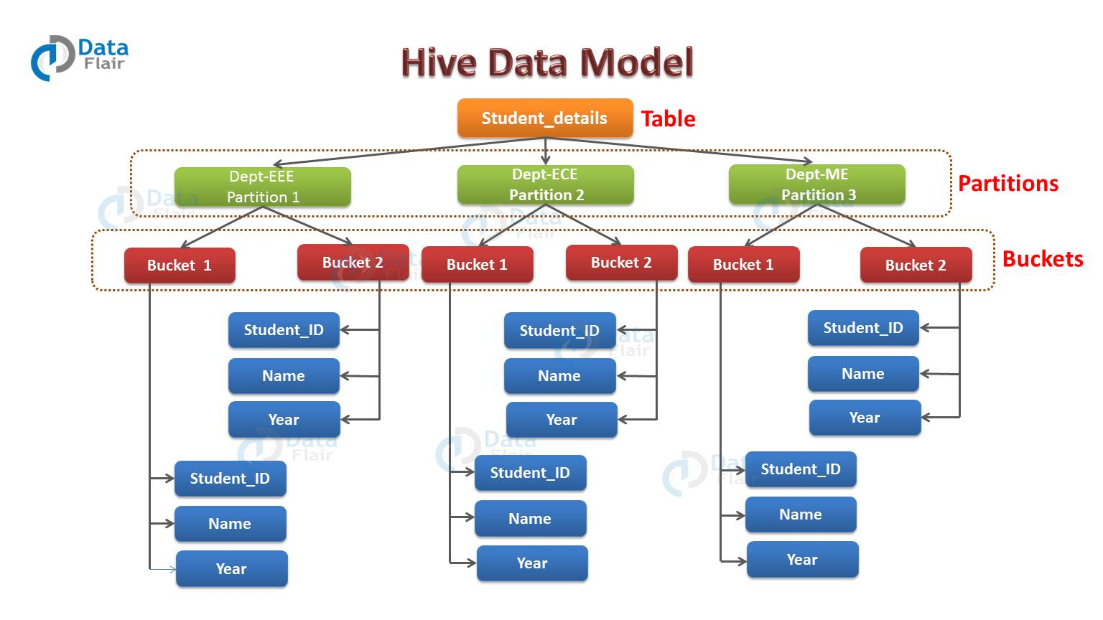

Slide 7
Tuning & Optimizing Spark

Slide 8
Setting Configs
Template that provides a mechanism to launch your SparkSession with a set of parameters on launch
To use this file set the parameters of your choice and remove the .template extension
Global settings
Another way is to set them directly in your Spark application
More ideal for situations where a user could have multiple different apps with different settings
Apps can be started with the spark-submit functionality with configs
All properties set in the Spark app will override the spark-defaults.conf

Slide 9
Scaling Spark for Large Workloads
Goal is to avoid job failures due to resource starvation or gradual performance degradation.
Static vs. Dynamic Resource Allocation
Dynamic allows Spark to request and shutdown resources as needed to avoid failures
Dynamic is more helpful during streaming applications when resources can be released for other apps
spark.dynamicAllocation.enabled true
spark.dynamicAllocation.minExecutors 2
spark.dynamicAllocation.schedulerBacklogTimeout 1m #used when there are pending tasks not schedules (waiting for 1m)
spark.dynamicAllocation.maxExecutors 20
spark.dynamicAllocation.executorIdleTimeout 2min #used to shutdown executors when they are idle

Slide 10
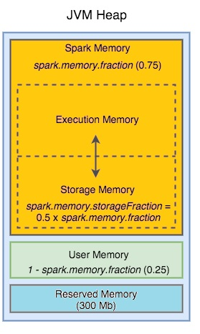
Executor’s Memory & Shuffle Service
Need an understanding of how memory is laid out and used by Spark so that executors are not starved of memory or troubled by JVM garbage collection
spark.executor.memory 600 #amount of memory for each executor
spark.memory.fraction 0.75 #default is 60% execution and 40% storage

Slide 11
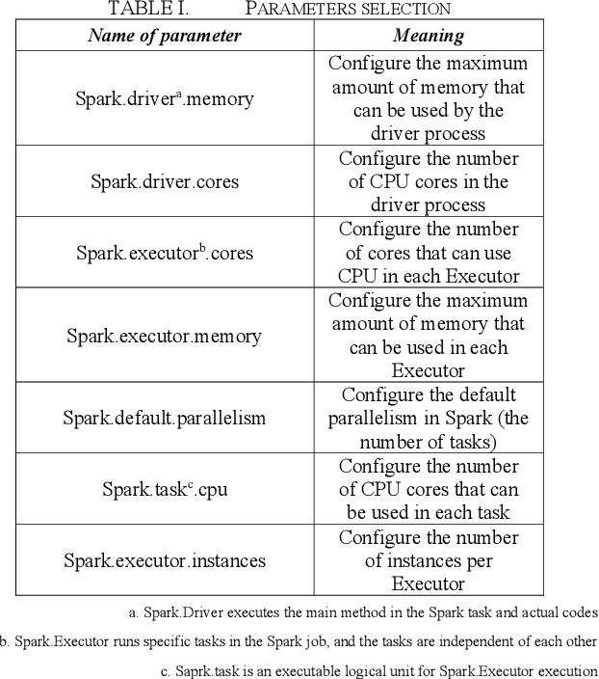
Execution memory is used for Spark shuffles, joins, sorts, and aggregations.
Since different queries may require different amounts of memory the fraction of available memory to dedicate to this can be tricky to tune but its easy to adjust.
Storage memory is used for caching user data structures and partitions derived from DataFrames

Slide 12
So what is a shuffle?
Why it Happens: As you process data in a distributed system, certain operations necessitate a different data grouping. For instance, when dealing with a key-value dataset and the need arises to group all values by their respective keys, ensuring that all values for a given key end up on the same partition is imperative.
How it Works: To achieve this grouping, data from one partition might need to be moved to another partition, potentially residing on a different machine within the cluster. This movement and reorganization of data are collectively termed shuffling.
Performance Impact: Shuffling can be resource-intensive regarding both time and network utilization. Transferring and reorganising data across the network can considerably slow down processing, especially with large datasets.
Partitions
Data is read from the partition on disk into contiguous blocks on memory
Data may need to be re-partitioned in Spark once its read to increase Spark efficiency
Small file problem
Many small partition files can create a large amount of disk I/O and performance degradation thanks to filesystem operations such as opening, closing, and listing directories which can be slow
Shuffle Partitions
Created during the shuffle sage.
Default is 200 which can be reduced to avoid the small file problem
spark.sql.shuffle.partitions
Notes:
https://www.linkedin.com/pulse/apache-spark-basics-101-shuffling-transformations-shanoj-kumar-v#:~:text=Published%20Sep%2020%2C%202023,partitions%20of%20a%20distributed%20dataset.

Slide 13
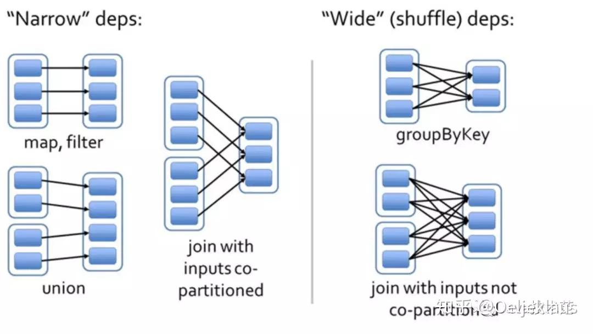

Slide 14
Configs to tweak I/O during shuffles
Config | Default/description
spark.driver.memory | 1GB default. Amount of memory allocated to the Spark driver to receive data from the executors. Only change this if you expect to return a lot of data back to the driver (your session).
spark.shuffle.file.buffer | 32 KB default. Recommended is 1MB. Allows Spark to do more buffering before writing the final map results back to disk.
spark.file.transferTo | Default is true. Setting it to false will force Spark to use the file buffer to transfer files before finally writing to disk; this will decrease the I/O activity.
spark.shuffle.unsafe.file.output.buffer | Default is 32KB. This controls the amount of buffering possible when merging files during shuffle operations. In general, large values are more appropriate for larger workloads, whereas the default works for smaller workloads.
spark.io.compression.lz4.blockSize | Default is 32KB. Increase to 512KB. You can decrease the size of the shuffle file by increases the compressed size of the block.
spark.shuffle.service.index.cache.size | Default is 100m. Cache entries are limited to the specified memory footprint in byte.
spark.shuffle.registration.timeout | Default is 5000 ms. Increase to 120000 ms.
spark.shuffle.registration.maxAttempts | Default is 3. Increase to 5 if needed.

Slide 15
Caching and Persistence
cache() stores as many of the partitions read in memory across Spark executors as memory allows.
If there is more data than fits into memory you get what's called disk spill, this is where the remaining data is partitioned into new disk blocks for Spark to access. This creates a HUGE slowdown.
persist() provides more control over cache()
MEMORY_ONLY – This is the default behavior of the RDD.cache() method
MEMORY_ONLY_SER – This is the same as MEMORY_ONLY but the difference being it stores RDD as serialized objects to JVM memory. It takes lesser memory (space-efficient) then MEMORY_ONLY as it saves objects as serialized and takes an additional few more CPU cycles in order to deserialize.
MEMORY_ONLY_2 – Same as MEMORY_ONLY storage level but replicate each partition to two cluster nodes.
MEMORY_ONLY_SER_2 – Same as MEMORY_ONLY_SER storage level but replicate each partition to two cluster nodes.
MEMORY_AND_DISK – This is the default behavior of the DataFrame or Dataset. In this Storage Level, The DataFrame will be stored in JVM memory as a deserialized object. When required storage is greater than available memory, it stores some of the excess partitions into the disk and reads the data from the disk when required. It is slower as there is I/O involved.
MEMORY_AND_DISK_SER – This is the same as MEMORY_AND_DISK storage level difference being it serializes the DataFrame objects in memory and on disk when space is not available.
MEMORY_AND_DISK_2 – Same as MEMORY_AND_DISK storage level but replicate each partition to two cluster nodes.
MEMORY_AND_DISK_SER_2 – Same as MEMORY_AND_DISK_SER storage level but replicate each partition to two cluster nodes.
DISK_ONLY – In this storage level, DataFrame is stored only on disk and the CPU computation time is high as I/O is involved.
DISK_ONLY_2 – Same as DISK_ONLY storage level but replicate each partition to two cluster nodes.
When to cache and persist
Dataframes commonly used during iterative ML training
DFs accessed commonly for doing frequent transformations during ETL or building data pipelines

Slide 16
Joins
Merging data by a common key
Recall from 6210: inner joins, outer joins, left joins, right joins
Broadcast hash join
Hash Join is performed by first creating a Hash Table based on join_key of smaller relation and then looping over larger relation to match the hashed join_key values.
it saves shuffling cost
Shuffle hash join
Shuffle Hash Join involves moving data with the same value of join key in the same executor node followed by Hash Join
More expensive than broadcast hash join due to shuffling
Shuffle sort merge join
Sort join involves, first sorting the relations based on join keys and then merging both the datasets(think of merge step of merge sort).
This is the default join strategy and can be disabled with: spark.sql.join.preferSortMergeJoin
Broadcast nested loop join
In this strategy, the cartesian product(similar to SQL) of the two relations is calculated to evaluate join.
Very slow strategy. This is generally, a fallback option when no other join type can be applied

Slide 17
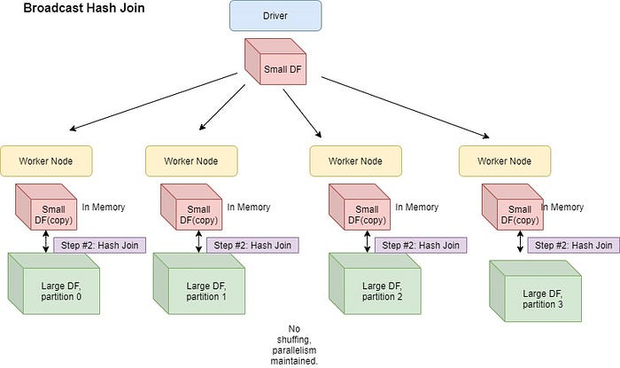

Slide 18
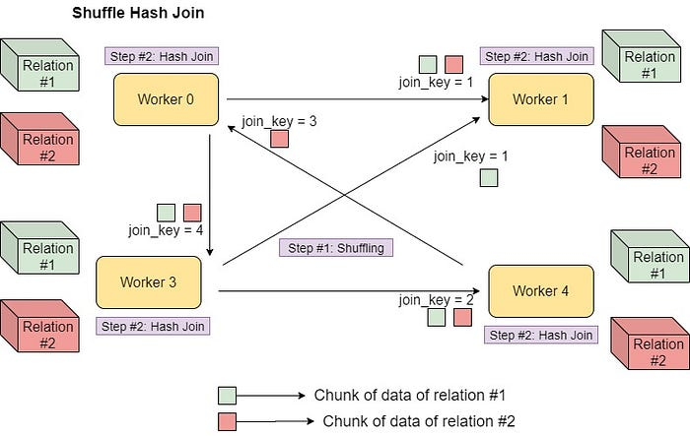

Slide 19
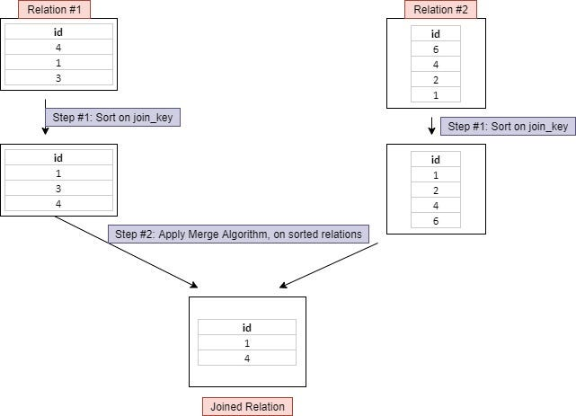
Shuffle sort-merge join

Slide 20


